Slide 1
Writing style
Plain English. Topic sentences. Word order. Creating flow. Tight writing. Parallel structures. Style matters

Slide 2
Plain English
Plain English is “the art of using language that the intended audience can understand and act upon from a single reading”. This concept has been widely adopted by manygovernment and legal organisations, and, in some countries, new laws must now be drafted in plain English. At Cambridge University, there is even a Professor of Plain English. The Plain English Campaign that began in 1979 has promoted the use of crystal clear language and campaigned against jargon, gobbledygook, and other confusing language. The campaign also recognises that appearance matters and that the design, typeface, and layout of a paper can be as important as the language for conveying meaning. The campaign website provides free guides to plain English, details of training courses and a range of example material including a collection of gobbledygook entitled “Utter drivel”. The website also includes advice about scientific writing. In the following sections, we outline our own tips and examples of how to write in plain English.

Slide 3
Topic sentences
Effective writing is writing that works. It does the job without anyone having to ask for further explanation. If it informs, it does so clearly – the reader does not have to ask for more information.
Elizabeth Murphy

Slide 4
Before you begin writing a paragraph, you must have a clear concept of what it is going to be about. A paragraph can be beautifully constructed but can be difficult to understand if it is not organised around a defined topic. Organising your thoughts in each paragraph can be easily achieved by using a topic sentence. Topic sentences begin a paragraph and explain what it will be about. The topic sentence creates the expectation of what the paragraph will be about and the supporting sentences fulfil that expectation. For this reason, topic sentences are an essential tool for organising paragraphs and for improving the readability of your paper. Once the topic sentence has been correctly framed, the paragraph is completed with supporting sentences that give all the remaining information that the reader needs to know. Topic sentences are especially useful for writing the introduction and discussion and, to an extent, the results section.

Slide 5
In the methods and abstract, the standard subheadings tend to replace the need for topic sentences. If a paragraph begins with a clear topic sentence, you immediately get a good idea of what information will follow. For example, a sentence such as Enterovirus infections in the neonatal period are common and are associated with significant morbidity and mortality makes the paragraph content clear. If you cannot write in one clear sentence what your paragraph is going to be about, then perhaps you do not need to include the paragraph at all. If you have multiple messages in your paragraph, you will need to deconstruct it into multiple paragraphs or tie the messages together in a single theme.

Slide 6
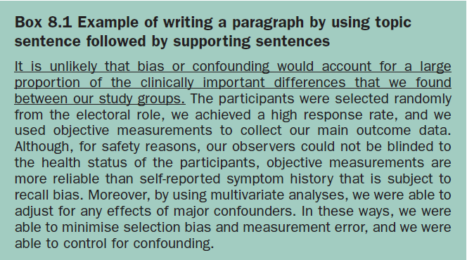

Slide 7
Subjects, verbs, and objects
The simplest and most easily understood sentences are constructed in a subject–verb–object format. The subject is a noun or noun cluster that begins the sentence and the object is the noun or noun cluster that ends the sentence. The two parts are then joined by a verb or verb cluster in the centre. If we take the sentence However, cases are difficult to ascertain through retrospective population studies, you will see that this is made up of a conjunction (However), a subject (cases), a verb cluster (are difficult to ascertain) and an object (through retrospective population studies) that is a noun cluster. Similarly, the sentence Hospital statistics show that respiratory infections occur mostly in winter, has a subject (hospital statistics), a verb (show) and an object (that respiratory infections occur mostly in winter). Both the subject and object are noun clusters.

Slide 8
It is important to understand this construction for analysing sentences to make them work better and flow together nicely. Of course adjectives, adjectival phrases, and clauses can be thrown in, but, if you deviate too far from the subject–verb–object format, your sentence will be weighed down by too many messages. Sentences become more complicated when they are made up of two simple sentences strung together or when additional phrases and clauses are added to make a compound sentence. The construction of these types of sentences is discussed in more detail in the following chapters.

Slide 9
Creating flow
There are two main methods for maintaining a flow of ideas from one sentence to the next. One method is to use conjunctions or transition words to link sentences. Classical transition words, such as although, therefore, however, for example, etc., are useful for joining things together. Nevertheless, you cannot keep using transition words throughout a paragraph.
Another method to create flow between sentences is to link the beginning (or subject) of the sentence to the end (or object) of the previous sentence. Linking subjects to objects between sentences helps to maintain ideas in the reader’s mind because it avoids any abrupt change of thoughts when a full stop is reached.

Slide 10
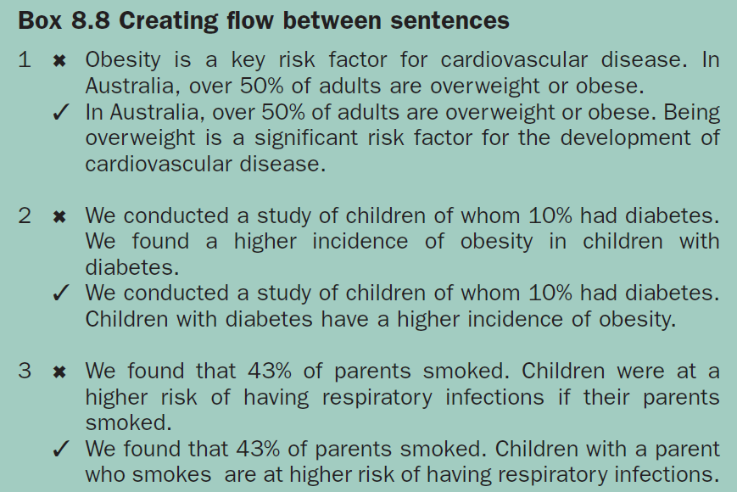

Slide 11
Tight writing
Tight writing is the art of achieving brevity by using short, concise sentences. Given that every book or article on writing recommends this style as a matter of course, it is surprising that so few writers aspire to this ideal. Readers love sentences and paragraphs that have a minimum number of words and that only include the information that they really need.

Slide 12
You must write tightly if you want to please your readers. Readers are busy people who want to be able to understand your paper quickly and do not want to spend time sorting out meanings from meandering text. Tight writing is a simple process. All you have to do is put your thoughts down in a sentence, then be your own best critic and see how many words you can leave out. Finally, when you have a series of short, concise sentences, you need to arrange them in a logical order and join them up to create flow. In doing this, you suddenly have a neat way to tell your story. This is a skill that is certainly worth perfecting if you would like to publish productively. If you follow this formula, you will automatically please your readers, reviewers, and publishers. In doing this, you will also earn yourself respect as a “good writer”, which is a reputation worth striving for.

Slide 13
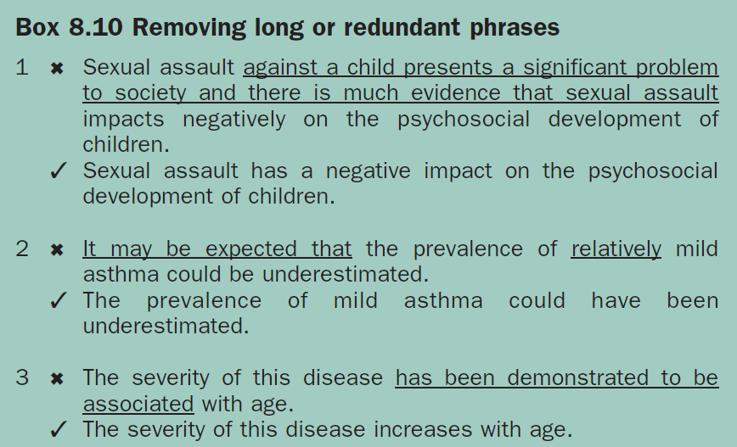

Slide 14
Parallel structures
By using the same sequences of word clusters both within and between sentences, you create “parallel sentence structures”. Parallel structures improve readability by creating a smooth, organised flow of thought. By establishing repetitive patterns, you introduce good structure to your writing because you present your ideas in a consistent way. Sentences that have an inconsistent, or non-parallel, structure inhibit thought patterns. By giving too many ideas that are presented in different word orders from one another, non-parallel sentences can become brain-teasers.

Slide 15
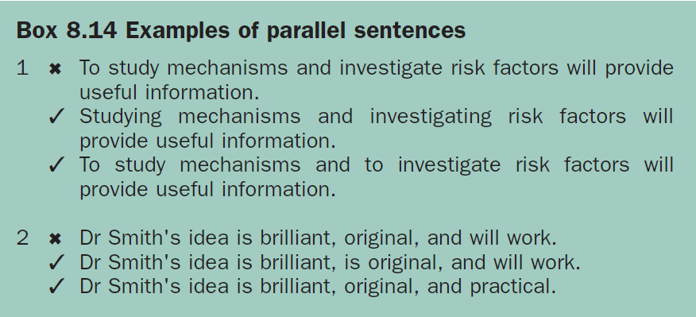

Slide 16
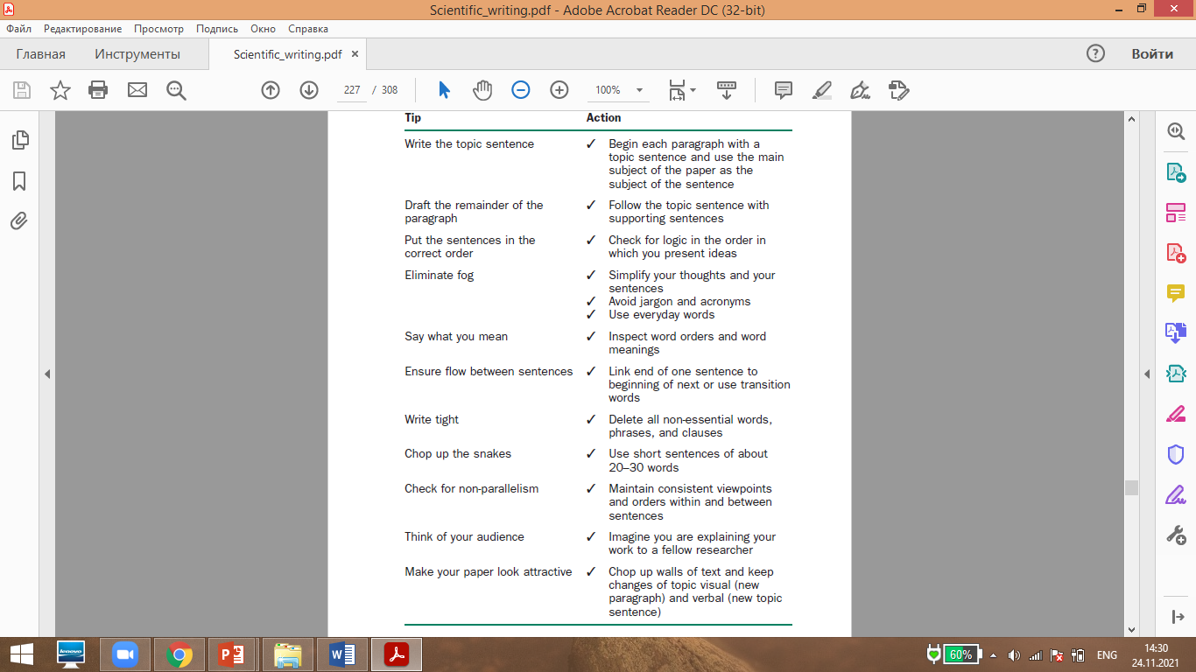
Style matters

